Slide 1
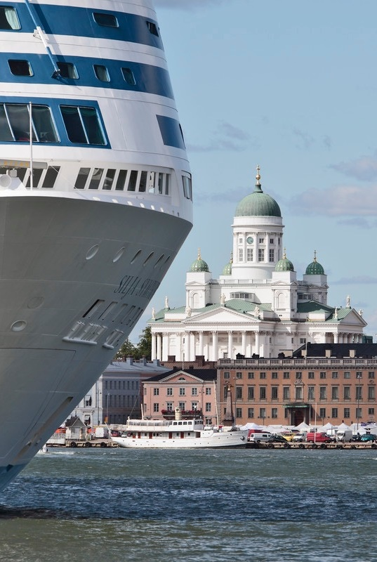


LNG BUNKERING IN PORT OF HELSINKI – SAFETY MANUAL
Go LNG Seminar
Aino Rantanen
Quality and Environmental Manager
6th Sept 2017
ESITYKSEN NIMI
Tekijän Nimi
27.8.2015

Slide 2
MAIN PORT FOR THE FINNISH
FOREIGN TRADE – BECOMING THE WORLD’S
BIGGEST PASSENGER PORT?
St. Petersburgi
Tallinn
Ust-Luga
Stockholm
Grangemouth
Århus
Riga
Teesport
Hull
Travemünde
Klaipeida
Immingham
Gdynia
Felixstowe
Bremerhaven
Rostock
Gdansk
Tilbury
Hampurg
Lybecki
Amsterdam
Zeebrugge
Rotterdam
Ghent
Antwerpen
Bilbao
Ferrol
Santander
Rouen
Notes:
140 Departures a week
Aarhus
Amsterdam
Antwerp
Bilbao
Bremerhaven
El Ferrol
Felixstowe
Gdynia
Ghent
Grangemouth
Hamburg
Hull
Immingham
Klaipeda
Lybeck
St. Petersburg
Riga
Rostock
Rotterdam
Rouen
Santander
Sheerness
Tallinn 88 a week
Teesport
Tilbury
Travemünde
Stockholm
Ust-Luga
Zeebrugge

Slide 3
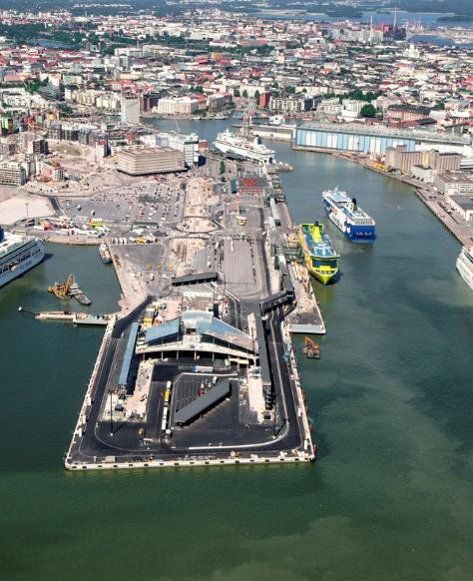
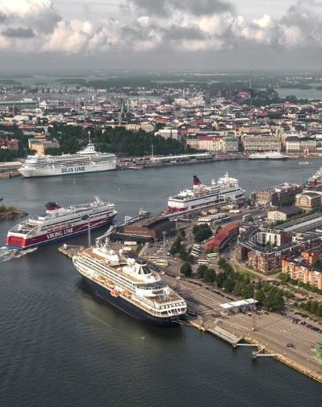
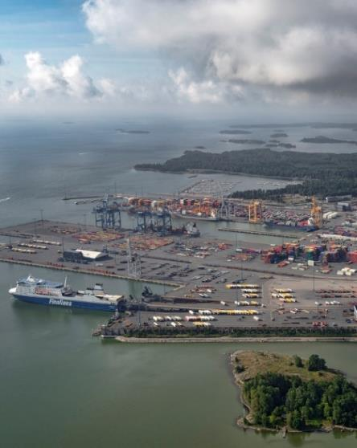
THREE DIFFERENT LOCATIONS / HARBOURS
SOUTH HARBOUR
KATAJANOKKA HARBOUR
WEST HARBOUR, HERNESAARI
VUOSAARI HARBOUR

Slide 4
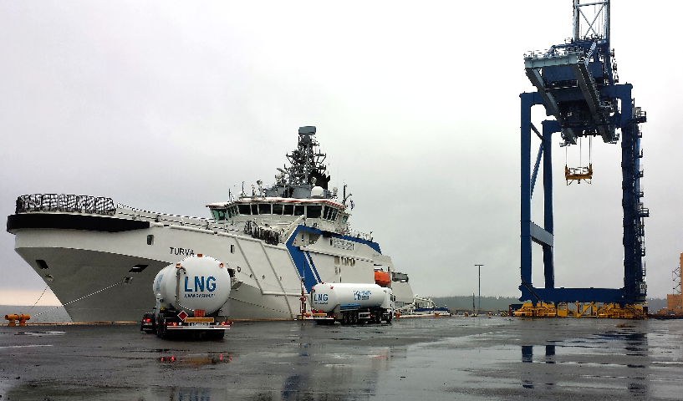
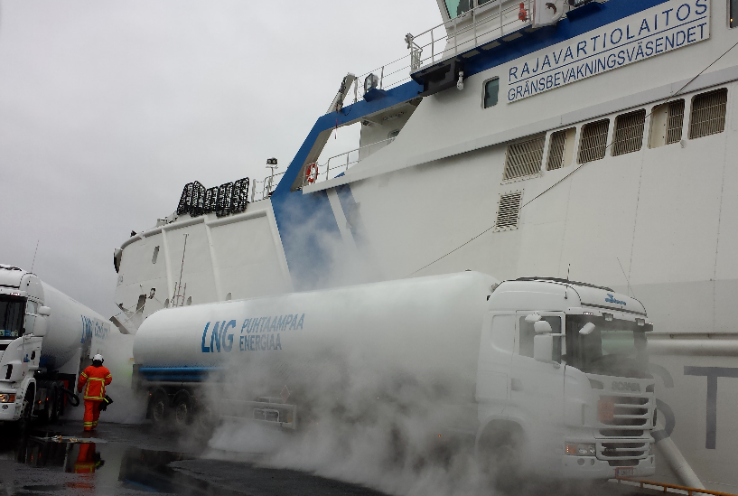
LNG BUNKERING IN PORT OF HELSINKI
Since summer of 2014 in Vuosaari Cargo Harbour, Finnish Border Guard’s vessel “Turva”
In 2017 Tallink Shuttle Megastar (Helsinki–Tallinn route) at the West Harbour
  approx. 5 times a week
  Turnaround times very short
Truck-to-ship bunkering
New LNG cargo vessels expected in 2018 (ESL Shipping, Containership)

Slide 5
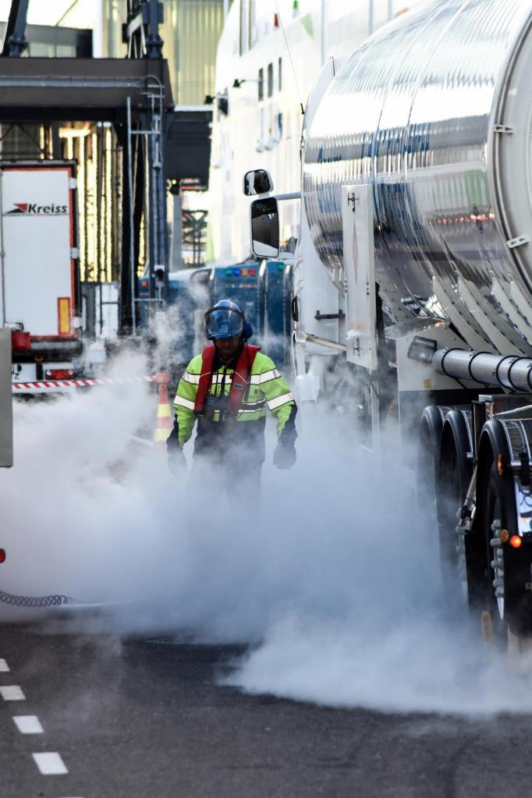
SAFETY MANUAL ON LNG BUNKERING IN THE PORT OF HELSINKI
Port of Helsinki wants to promote the safe use of LNG
Manual published in June 2017
Developed together with SSPA Sweden AB and Finnish authorities
Minimum requirements for shipping companies and LNG suppliers that wish to bunker LNG at the Port of Helsinki
Safety regulations and demands required for safe handling of LNG
Ship-to-ship and truck-to-ship operations

Slide 6

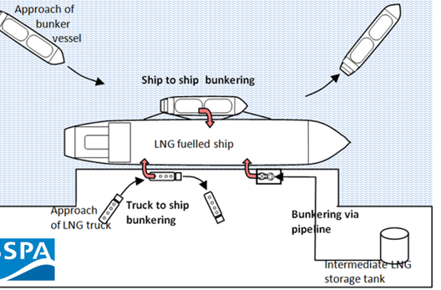
SAFETY MANUAL - CONTENT
Summary and recommendations
General information on LNG including general considerations for LNG bunkering
Regulatory framework
Risk assessments
Safety guidance
Bunkering procedures and requirements
LNG bunker supplier accreditation system
Emergency procedures
LNG bunkering education and training
LNG Bunker Checklists – IAPH examples

Slide 7
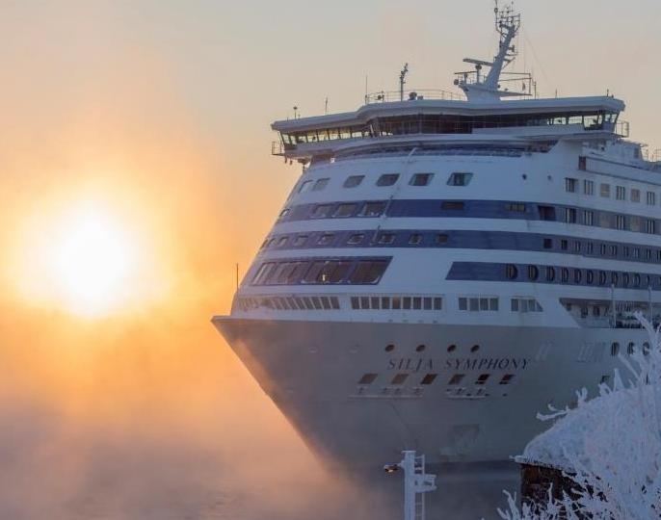
RISK ASSESSMENTS
Risk assessment of bunkering operations shall be conducted
Participants from
  Port of Helsinki
  Finnish Traffic Safety Agency
  The Helsinki City Rescue Department
  The Finnish Safety and Chemicals Agency (TUKES)
  Bunker supplier
  Bunker receiver
Recommended both qualitative and quantitative risk assessments, with professional / external risk expert
Qualitative risk assessment minimum
In case of simultaneous operations (cargo operations, passengers onboard / embarking etc.) comprehensive quantitative risk assessment needed

Slide 8
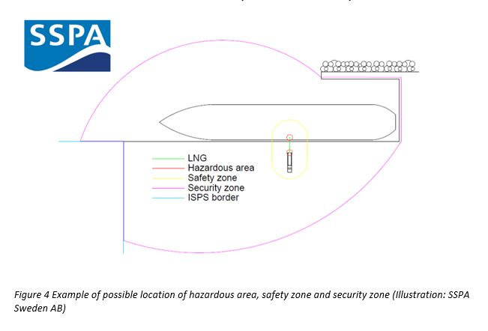
SAFETY GUIDANCE
Definition of hazardous areas
  areas where gas is or may be expected → requires special precautions for construction, installations and use)
Safety zones and security zones and restrictions inside zones
  Safety zone = restrictions during bunkering (control of ignition)
  Security zone: area where movement (ship traffic, shore-side operations) need to be monitored and controlled during bunkering

Slide 9
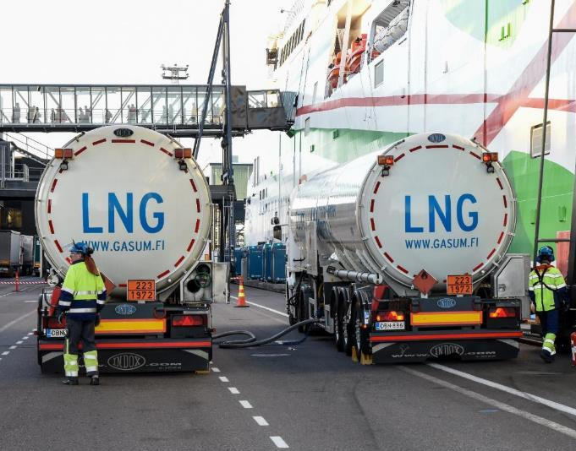
SAFETY GUIDANCE
Handling LNG in the operating area of Port of Helsinki
    Permits, notification requirements, signals,…
Simultaneous operations
Quantitative risk assessments required, only allowed if the risk is acceptable
Weather restrictions
Personal protective equipment
Emergency shut-down system
Distribution of responsibility

Slide 10
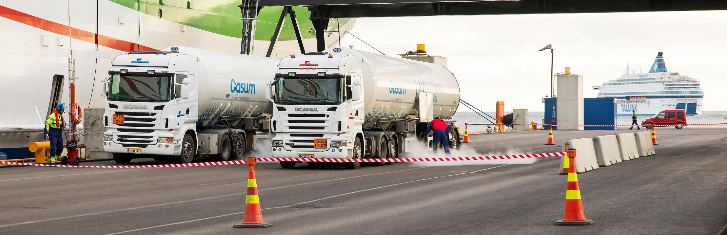
BUNKERING PROCEDURES AND REQUIREMENTS FOR BUNKER SUPPLIER
Steps before bunkering, during bunker transfer and after bunkering
  Check-lists, assessments, monitoring during bunkering, disconnection and finishing
Emergency procedures and instructions
Permit process for the supplier includes, in addition to Port of Helsinki, Finnish Transport Safety Agency (TRAFI), Helsinki City Rescue Department and Finnish Safety and Chemicals Agency (TUKES)

Slide 11
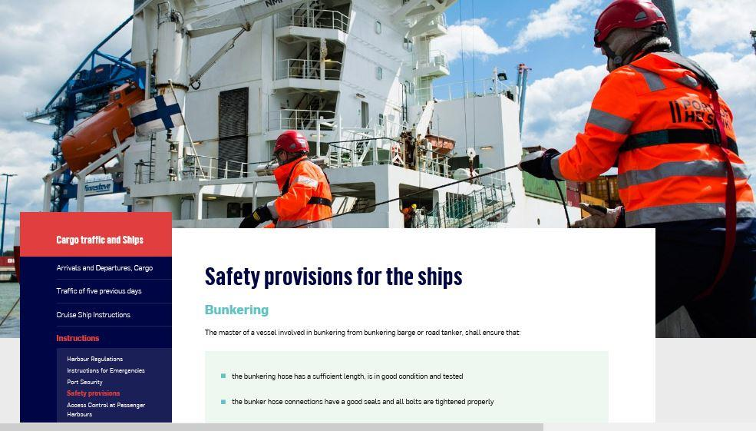
http://www.portofhelsinki.fi/en/cargo-traffic-and-ships/instructions/safety-provisions-ships

